Slide 1


Comparing
Technical Indicators
By Sarah

Slide 2

OBJECTIVE
The objective of this presentation is to compare the performance of two popular trading indicators, the Exponential Moving Average (EMA) and the Moving Average Convergence Divergence (MACD), in order to determine which indicator yields superior results in identifying potential reversals in financial markets. Additionally, this presentation aims to assess the individual effectiveness of EMA and MACD against other commonly used reversal indicators and determine which indicators demonstrate the most favorable performance overall.

Slide 3
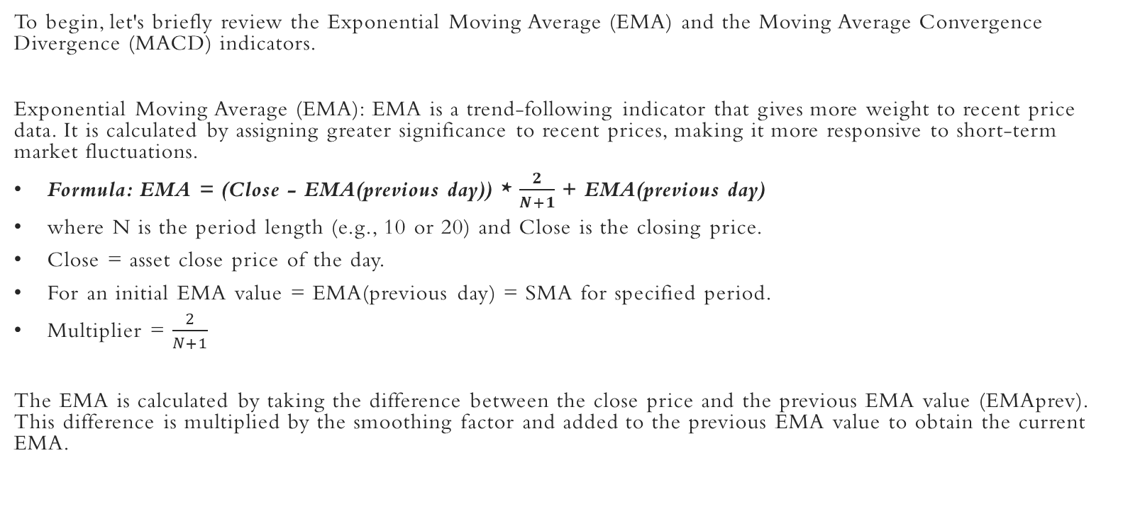
OVERVIEW OF THE EMA AND FORMULA

Slide 4
OVERVIEW OF THE MACD AND FORMULA
Moving Average Convergence Divergence (MACD): MACD is a versatile indicator that combines trend-following and momentum characteristics. It consists of two lines: the MACD line, which represents the difference between two moving averages, and the signal line, which is a moving average of the MACD line. The MACD line crossing above or below the signal line is often considered a potential reversal signal.
It is calculated as follows:
MACD=12-Period EMA − 26-Period EMA
Signal line = 9- period EMA of MACD Line
Histogram = MACD line - Signal line

Slide 5
Performance Comparison of EMA and MACD
Now, let's compare the performance of EMA and MACD in identifying reversals. We will analyze historical price data and assess the accuracy of each indicator in predicting price reversals.
Data Selection: We will use the SPY and select a substantial time period to ensure reliable results.
Evaluation Criteria: We will consider factors such as the reversal signals, and the magnitude of price movements following the signals.
Statistical Analysis: We will employ appropriate statistical measures, such as actual returns vs strategy returns, cumulative returns vs cumulative strategy returns, and sharpe ratio, to quantitatively assess the performance of EMA and MACD.

Slide 6
ENTRY AND EXIT CONDITIONS EMPLOYED FOR EMA
Buy Entry: When the 10 period EMA is > 20 period EMA.
Exit: When the 10 period EMA is < 20 period EMA.
Sell Entry: When the 10 period EMA is < 20 period EMA.
Exit: When the 10 period EMA is > 20 period EMA

Slide 7
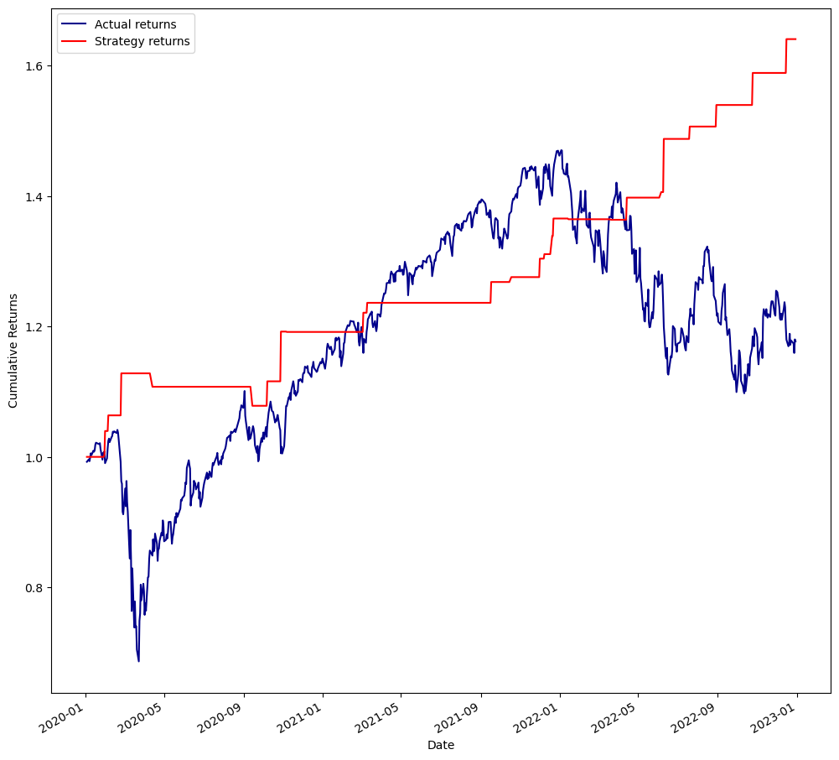
Strategy Backtest Result

Slide 8
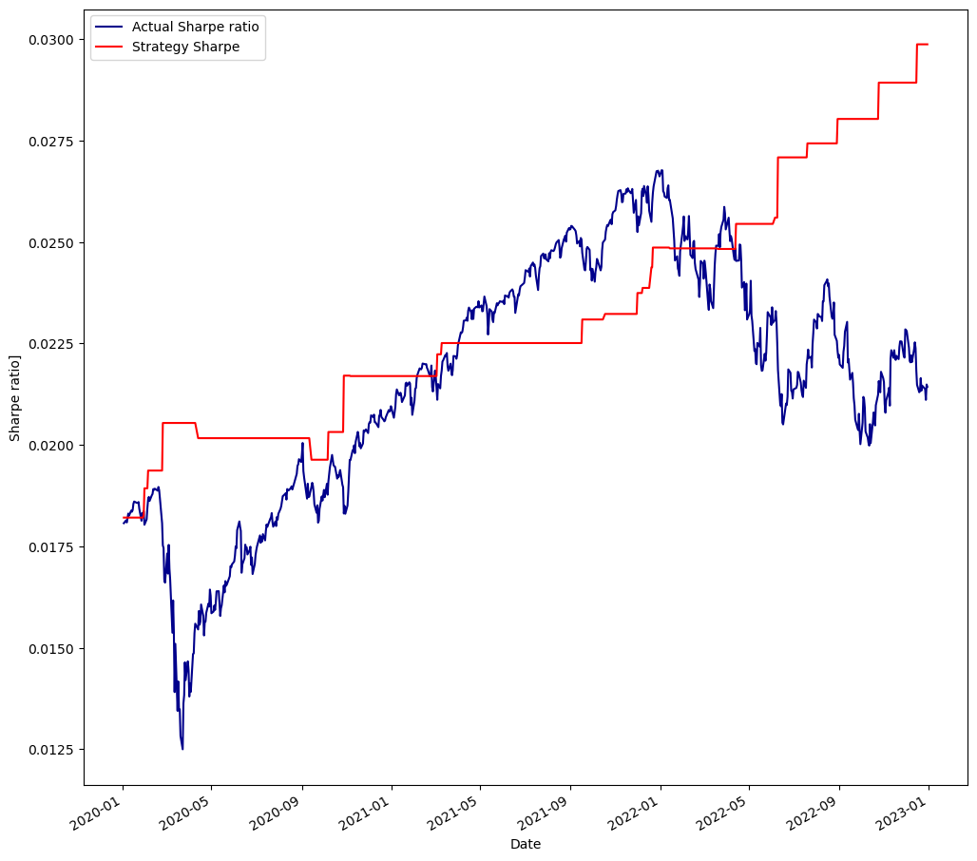
Sharpe Ratio Result

Slide 9




ENTRY AND EXIT CONDITIONS EMPLOYED FOR MACD
Buy Entry: MACD line > Signal line.
Exit: MACD histogram is negative.
Sell Entry: MACD line < Signal line.
Exit: MACD histogram is positive.

Slide 10
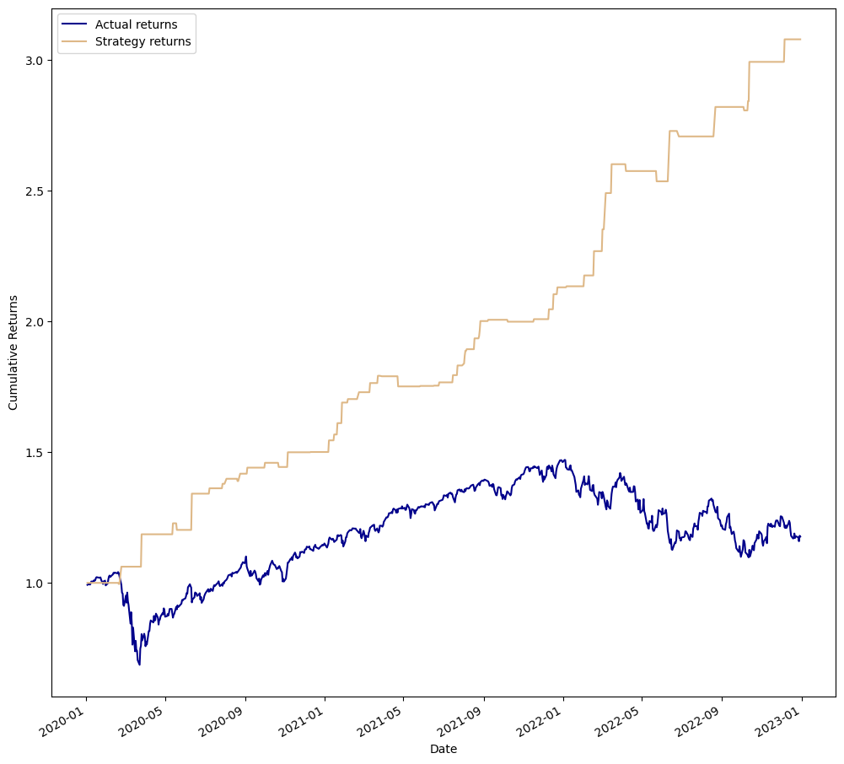
Strategy Backtest Result

Slide 11
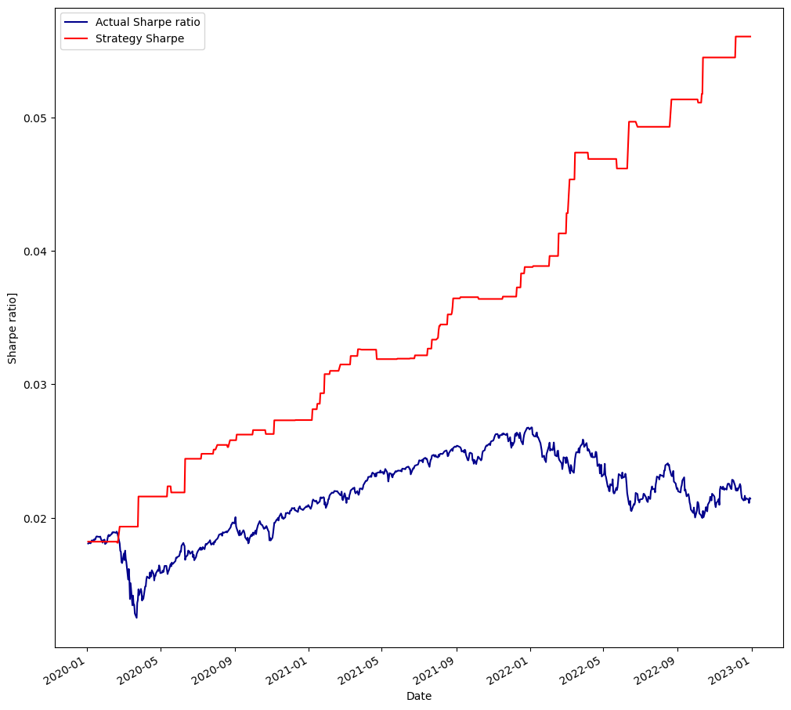
Sharpe Ratio Result

Slide 12

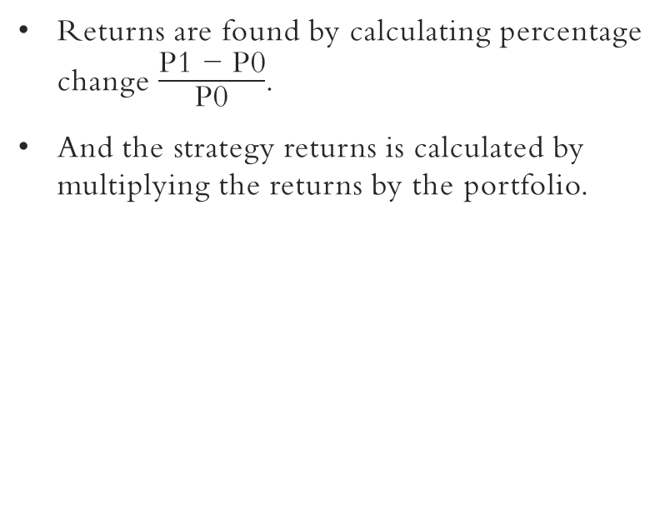
RETURNS FORMULA

Slide 13
FINDINGS
Based on the analysis conducted, i found that the MACD strategy outperformed the EMA strategy in terms of profitability.
The MACD strategy yielded a remarkable return of 3 times the initial investment, while the EMA strategy produced a comparatively lower return of 1.6 times the initial investment.
These findings indicate that the MACD strategy demonstrated stronger performance in identifying potential trend reversals and generating profitable trading signals.
The significantly higher return generated by the MACD strategy suggests its effectiveness in capturing larger price movements and maximizing profit potential.
Traders and investors may consider incorporating the MACD indicator into their trading strategies to enhance their decision-making processes and potentially achieve superior investment outcomes.

Slide 14
Conclusion
These results highlight the importance of carefully selecting and combining trading indicators to maximize profit potential. The MACD indicator, with its ability to capture larger price movements and provide timely signals, has proven to be a valuable tool for traders and investors.
By incorporating the MACD strategy into their trading approach, market participants can potentially enhance their decision-making processes and improve their investment outcomes.
As with any investment approach, it is recommended to conduct thorough backtesting, practice risk management techniques, and remain vigilant in evaluating and adjusting the strategies as market conditions evolve. With a disciplined and well-informed approach, traders can leverage the power of the MACD strategy to navigate the dynamic landscape of financial markets and strive for consistent profitability.

